Slide 1
Learning a Foreign Language: Can Features Influence Learning?
Rebecca E. Knoph
Elizabeth G. Kusel
Erin M. Buchanan
Notes:
Today I will be briefly discussing research on the influence of features of the target language—or the language we wish to learn—on the ease of learning this language as it relates to our native language.

Slide 2
Basic Theories
Chomsky (1984)- Universal Grammar
Certain aspects of language are innate
Supported by grammatical speech patterns
Krashen (1981)- Input Hypothesis
We learn best when new knowledge of the target language is just a little more difficult than the current level.
Krashen (1981)- Monitor Model
Acquisition is subconscious
How we learn as children
Learning is a conscious effort; usually requires formal instruction
How we learn as adults
Notes:
First, we will build the foundation for language learning. The most famous theory is Universal Grammar, hypothesized by Chomsky. He claims we are born with the special ability for language. This is why most languages are similar in key ways.
Krashen’s first model, the input hypothesis model, is 1 of 5 theorized in 1981. He states that learning a second language occurs best when you are presented with new stimuli that are just slightly above your current level of the language.
His second model continues by differentiating between acquisition, which occurs automatically and mostly when we are children; versus true learning that requires a conscious effort—which is what many of us are stuck trying to do as adults.
Chomsky- support- We do not tend to make mistakes that violate the rules of grammar
i + 1; where i is the current level of knowledge of the target language
Chomsky, N. 1968: Language and mind. New York: Harcourt Brace Jovanovich.
Krashen, S. 1981: Second language acquisition and second language learning. Oxford: Pergamon.

Slide 3
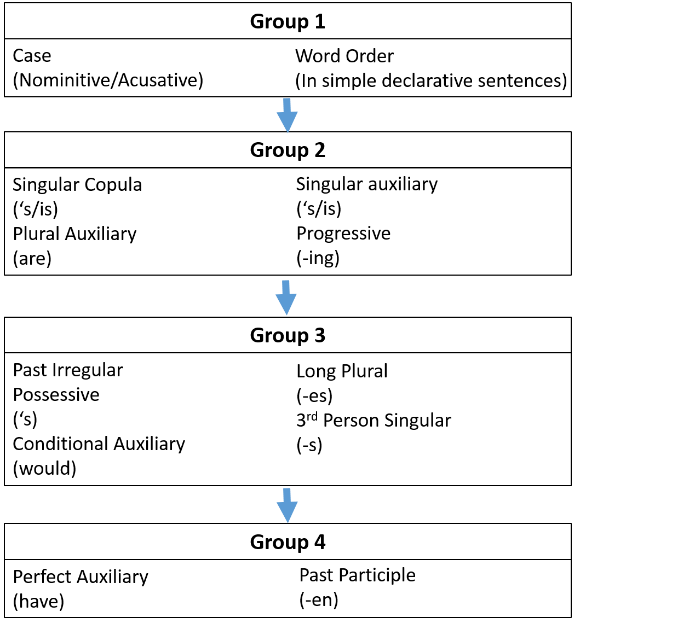
Acquisition of Second Languages
Target language acquired in the same pattern as native language.
Chinese and Spanish students learned 13 groups of English morphemes in the same pattern as natives.
Dulay et al. (1982)
Notes:
Further, it seems that we acquire target languages in the same pattern that we do our native languages.
For example, Dulay found that Chinese and Spanish students learned 13 groups of English morphemes in the same pattern that natives tend to learn English morphemes. This extends beyond the acquisition of morphemes and includes learning patterns of grammar structure and patterns of common mistakes such as “I hurted myself” or “I is going to the store”.
Dulay, H., Burt, M., and Krashen, S. 1982: Language two. New York: Oxford University Press.

Slide 4
Interference Hypothesis
Interference between native and target language happens when we unconsciously transfer native rules and structure onto the target language simply due to habit.
Usually considered a hindrance. But does it have to be?
Potentially, similar languages might have positive transfer where the match of native and target language improve early learning.
Notes:
Which brings us to our current research with the interference hypothesis.
Although most researchers discuss that becoming fluent in a language similar to our native is more difficult than learning a new language that is very different, this may be debatable. In the long run, this may involve “turning off” those ideas of how surface structures function. However, when just beginning to learn a language, these similarities may prove to be very helpful for quick learning of very simple pieces of the language.

Slide 5
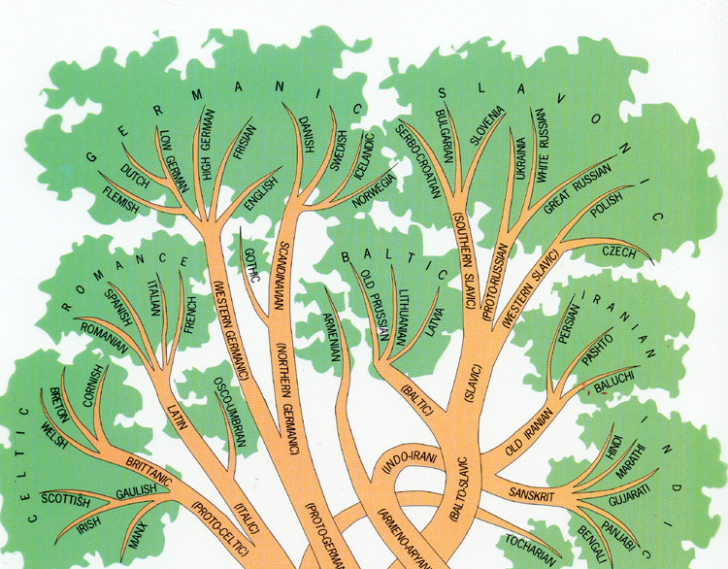
Branches of Language
Germanic
Western Germanic
English, Dutch, German
Northern Germanic
Swedish, Norwegian, Danish
Romance
Italic
Italian, French, Spanish
Anthropology.net
Notes:
We asked native English speakers to learn a small amount of two languages: Italian and Swedish.
English is a Germanic language similar to Dutch and German, as these are all Western Germanic.
Swedish, similarly, is a Germanic language, but differs in that it is a little more similar to Norwegian and Danish, as these are all Northern Germanic.
Conversely, Italian is a romance language similar to French and Spanish, as these are all Italic, but is not very similar at all to English.

Slide 6
Participant demographics
111 participants volunteered for this study for course credit
63% female; 37% male.
Average age: 19.41 years old
SD= 4.00
Ranged from 18-50 years
Notes:
Our participants came from a pool of students enrolled in the introductory psychology course at our university. They signed up online and received course credit for their efforts.
We did have a larger population of females and the mean age was fairly young—less than 20 years old. However, this is a fairly common issue for university studies.
Many spoke Spanish, but no one excluded due to bilingual abilities

Slide 7
Method
Participants were directed to the online study via Qualtrics.
Participants completed a short demographics section
Previous experience with Italian, Swedish, or Latin that could result in their data being omitted from analysis.
Notes:
Participants first answered some basic demographics questions about their age and gender. We also asked about previous experience with Swedish, Italian, Latin, or any bilingual abilities that could potentially produce artifacts in our results. No participants showed signs of this experience.

Slide 8
Method, Continued
Participants began a lesson about Italian or Swedish
All participants received both lessons, randomized by Qualtrics.
Lesson difficulty gradually increased from recognition to matching to sentence translation.
The lessons were exactly the same.
Notes:
Lessons required participants to answer multiple questions about the languages beginning with simple recognition and gradually increasing in difficulty until participants were asked to translate short sentences.
The lessons were exactly the same, with questions being given in the exact same order and with the same answer choices available.
As I show you examples, you will be able to compare the Italian version of the question on the left with the Swedish version on the right.

Slide 9
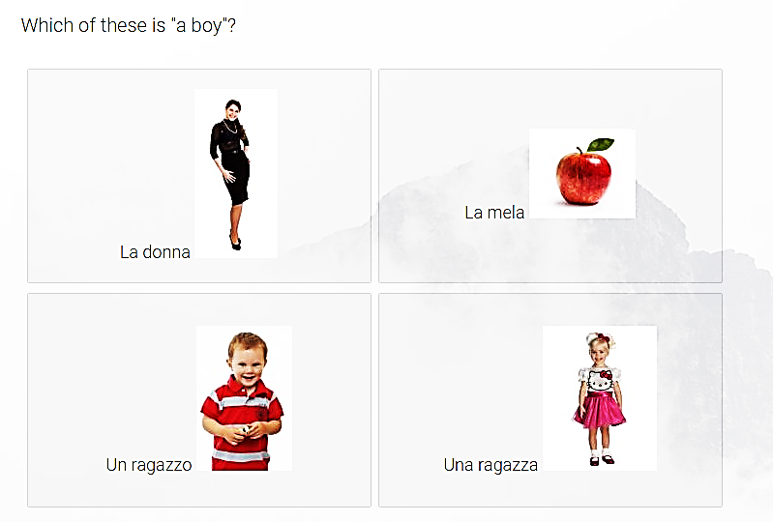
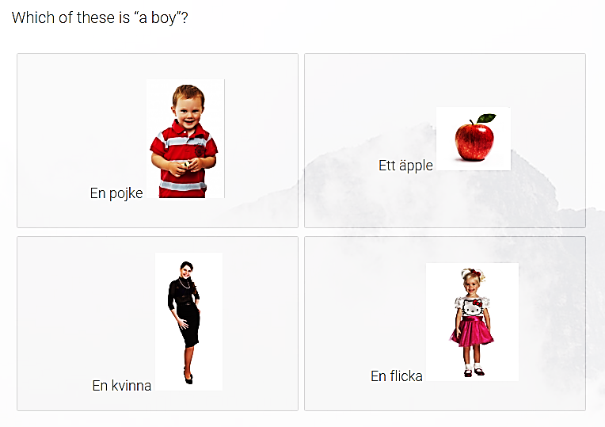
Screening Questions
Notes:
Four questions were asked to form a basis of the language. These were very simple questions formatted like the one here. By reading each option, participants gain knowledge of four new words and can commit these words to memory by translating from English to the target language, or from picture to the target language.
These questions were used for screening during analysis. If a participant could not master at least 3 of these 4 questions, they were considered as not actively participating in, or misunderstanding, this study.

Slide 10
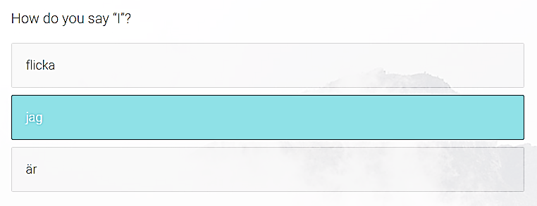
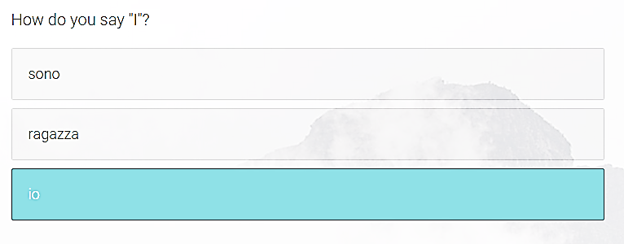
Recognition
Notes:
After that, the questions became increasingly difficult, beginning with the loss of pictures. Now, participants had to rely on their memory to correctly answer the same question.

Slide 11
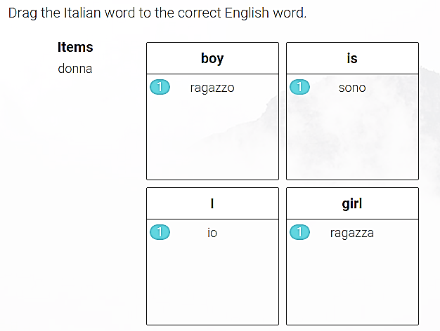
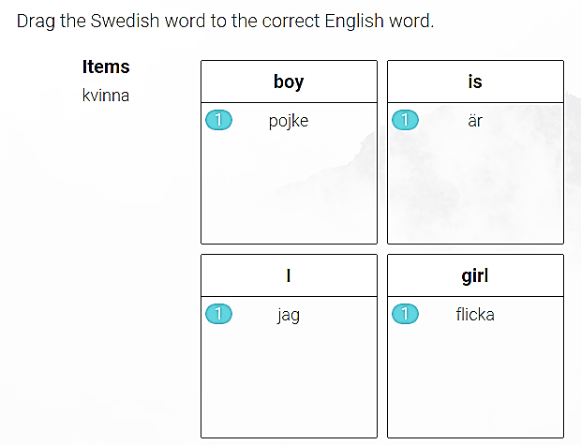
Matching
Notes:
Once a strong set of words were grasped, participants were asked to match words to the correct English word. This required participants to rely less on their ability to simply recognize the correct word. For instance, here they must now recognize that ragazzo and ragazza are Italian words with different meanings despite the small difference.

Slide 12
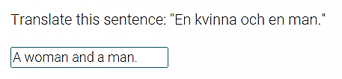
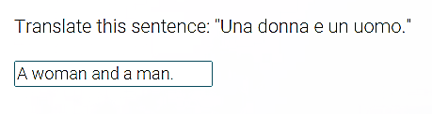
Sentence Translation
Notes:
Using all of the knowledge gained thus far, participants concluded by translating short phrases and sentences. Most of these contained a word or two that had not been seen before, but with some contextual clues could be guessed.
For instance, “a woman a man” were all words that had been seen before, but the word “and” had not. However, this should be easy to guess. This follows the input hypothesis. Technically, this is outside of the level of participants, but it is easily grasped.

Slide 13
Data Screening
Manually coded data from Qualtrics jargon to Excel
All questions weighted as one point.
Qualtrics rated matching as one point per word, so we created average scores for each question.
Data screening for assumptions was satisfactory.
Excluded participants:
1 person was excluded for missing data.
3 participants were excluded for missing screening questions.
11 outliers were identified, but remained in the analysis.
Notes:
If you have ever worked with Qualtrics, you know that the Excel file it imports to is a mess. We began by cleaning up this file manually.
For instance, Qualtrics creates different weights for more complicated questions. Each matching question required 8-10 columns of data. We reduced this scoring to one average column per matching question so that the weight would not be greater than that of multiple choice.
We also had to manually score each sentence translation. We allowed partial credit on these as well.
One participant had more than 5% of their data missing, and did not have their data replaced.
3 participants omitted out for missing to many of those first 4 MC questions
11 outliers were identified, but we allowed them to remain in the analysis WHY>

Slide 14
Data Analysis
Multilevel Model (Mixed Effects)
With a random intercept
Controlling for participants
Independent Variables
Language
Swedish or Italian
Type of question
Multiple choice, matching, or sentence translation
Dependent Variable
Accuracy
Notes:
We chose to run a multilevel model that allowed for the skill level of each participant to differ.
Our independent variables were the target language and the type of question being asked.
Our dependent variable was the accuracy of the answer to that question, with 0% being completely wrong, 100% being completely correct, and everything in between being partial credit.
MLM controlling for participant
Random intercept= allows for participant level to differ… some people are just better than others.
No average score for multiple choice. Every question went in there, but I controlled for the fact that every participant was in there multiple times. Why? Power.

Slide 15
MLM Results
 | B | Std.Error | DF | t-value | p-value
Recognition vs Matching Questions | -0.001 | 0.01 | 3991 | -0.05 | 0.96
Recognition vs Sentence Translation | -0.02 | 0.01 | 3991 | -1.60 | 0.11
Language Type | 0.09 | 0.01 | 3991 | 6.54 | < 0.001
Interaction: Recognition vs Matching X Target Language | -0.04 | 0.02 | 3991 | -2.02 | 0.04
Interaction: Recognition vs Sentence Translation X Target Language | -0.07 | 0.02 | 3991 | -3.60 | < 0.001
These slopes are significant. ΔΧ²(1) = 241.17, p < .001
Notes:
Here, we see that the type of question alone did not produce any significant difference in accuracy, but that the target language itself did.
Interestingly, there are also significant interaction effects between the type of question and the target language. Because of this, we examined all three types of questions separately in significant effects models.
Why no compare match with translate? Because we would have to recode it. Also, significant interaction so why bother.
Because both interaction effects were significant, we examined all three of the levels of type of question in the simple effects models. We broke this down by type of ques
tion.
Is this predicting better than just the average? Yes. The slopes are significant.

Slide 16
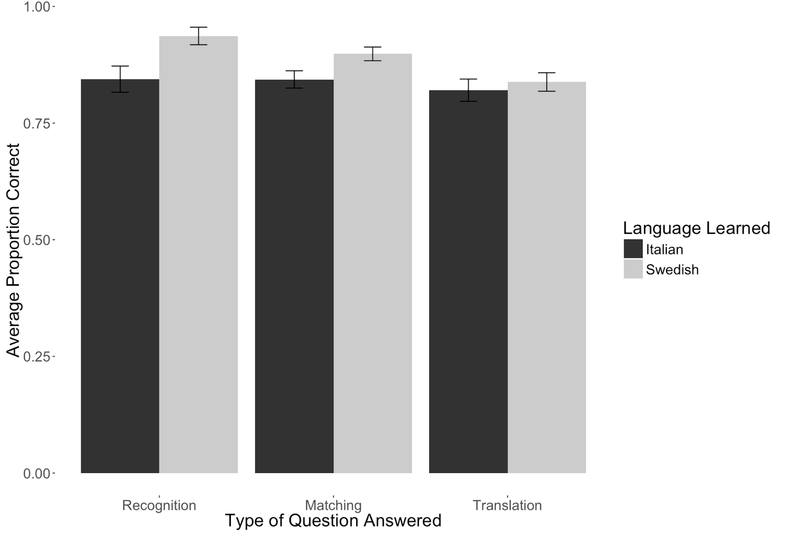
Results- Interaction Effect
*95% confidence interval bars
Notes:
Before we go into the numerical results of the interaction effects, I wanted to graphically showcase our results.
On the recognition and matching, participants scored significantly better on questions where Swedish was the target language.
However, this effect did not continue into the more difficult sentence translation questions, where the scores are almost the same.

Slide 17
Implications
Support for the interference hypothesis
Positive transfer: English and Swedish
We are more aware of the similarities between English and Swedish and can use these to our advantage.
Negative transfer: English and Italian
There are less similarities to be aware of, and we must find different ways to master this language than just comparing to English.
No significant difference for sentence translation
Positive/negative transfer no longer comes into play when translating sentences. Participants had to rely solely on memory.
Notes:
Thus, our research did support the interference hypothesis. Participants exhibited positive transfer when learning Swedish, as we expected. Conversely, we saw the more notable negative transfer when learning Italian.
Unfortunately, this transfer was not strong enough to provide help or burden participants when trying to translate sentences. With such little time—only about 20 minutes per language—there was just no way to solidify enough of the language information to memory and be able to use that context to predict the meanings of new words.
Small amount of time to learn… these are not solidified into memory.

Slide 18
Future Research
Spend more time learning languages
20 minutes is not very long! How about a day?
What about a longitudinal study spanning a few years?
Test other target languages
Instead of Swedish, test Norwegian.
Instead of Italian, test Romanian.
Test other native languages
Instead of all English natives, test Spanish natives or German natives.
Notes:
It is imperative that we continue this type of foreign language learning research as the world becomes more connected. We must continue to find ways to efficiently and effectively learn multiple languages if we wish to have the ability to interact with other cultures.
In the future, I hope to see this pilot study furthered with participants being given more time to learn languages—such as 24 hours per language or continued into a longitudinal design over the course of a few years.
I would also like to see other languages tested to prove that there is no anomaly in Swedish or Italian, such as learning Norwegian and Romanian.
Lastly, I would like to see the native language change from English to Spanish or German to test the generalizability to multiple native languages.

Slide 19
Rebecca Knoph
Rebecca.Knoph@gmail.com
Allinder115@live.missouristate.edu
Notes:
At this point, I would like to open the floor for questions or comments. If you wish to reach me for more information, you can contact me via either email.

Slide 20
Simple Effects
Participants scored significantly higher on recognition questions in Swedish than Italian.
t(1619) = 4.91, p < .001
Swedish M = 93.7%, SD = 0.24
Italian M = 84.4%, SD = 0.36
Participants scored significantly higher on matching questions in Swedish than Italian.
t(1187) = 5.49, p < .001
Swedish M = 89.8%, SD = 0.22
Italian M = 84.4%, SD = 0.28
Participants did not score significantly different on sentence translations between the two languages.
t(971) = 1.29, p = 0.20
Swedish M = 85.6%, SD = 0.21
Italian M = 84.3%, SD = 0.26
Notes:
Again, the recognition and matching questions contained significant differences at the p < .01 level, with the mean scores for Italian being 84.4% for both and for Swedish being 93.7% and 89.8%, respectively. In academic terms, this is a difference of a letter grade.
This was not the case for sentence translations where the means were 85.6% for Swedish and 84.3% for Italian.

